Slide 1
Genomics & Symbiosis
Ian Bishop
BIO-594_2019
3/21/19

Slide 2
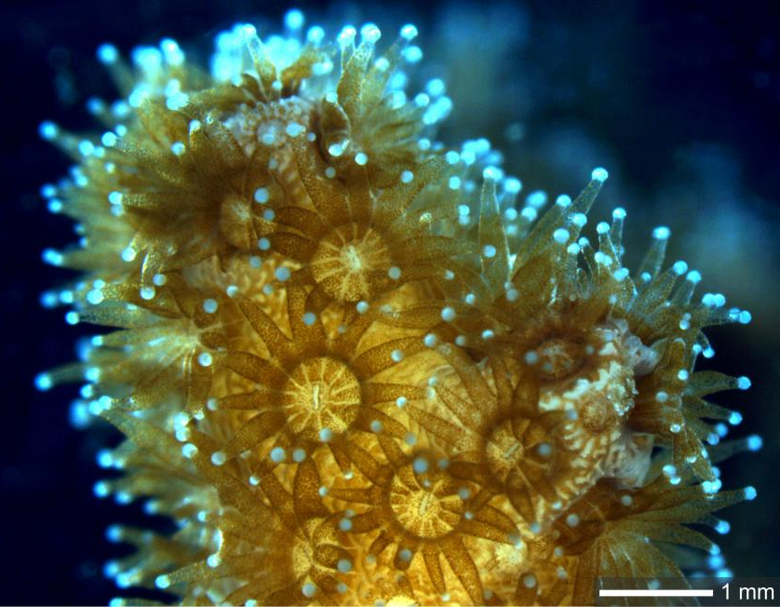
Outline
What is symbiosis?
Developmental symbiosis
Symbiosis and speciation
Genomic signatures of symbiosis
Some basics for next week’s discussion
Credit: Jaroslaw Stolarski, Polish Academy of Sciences, and Isabelle Domart-Coulon, National Museum of Natural History

Slide 3
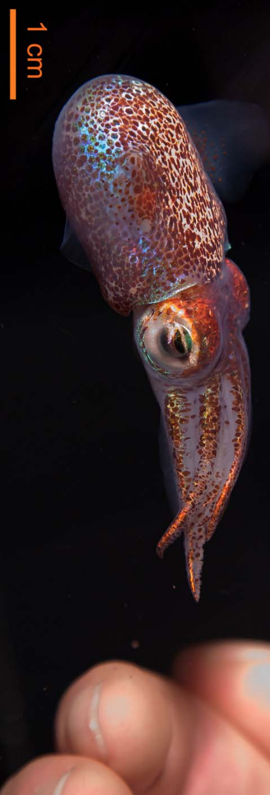
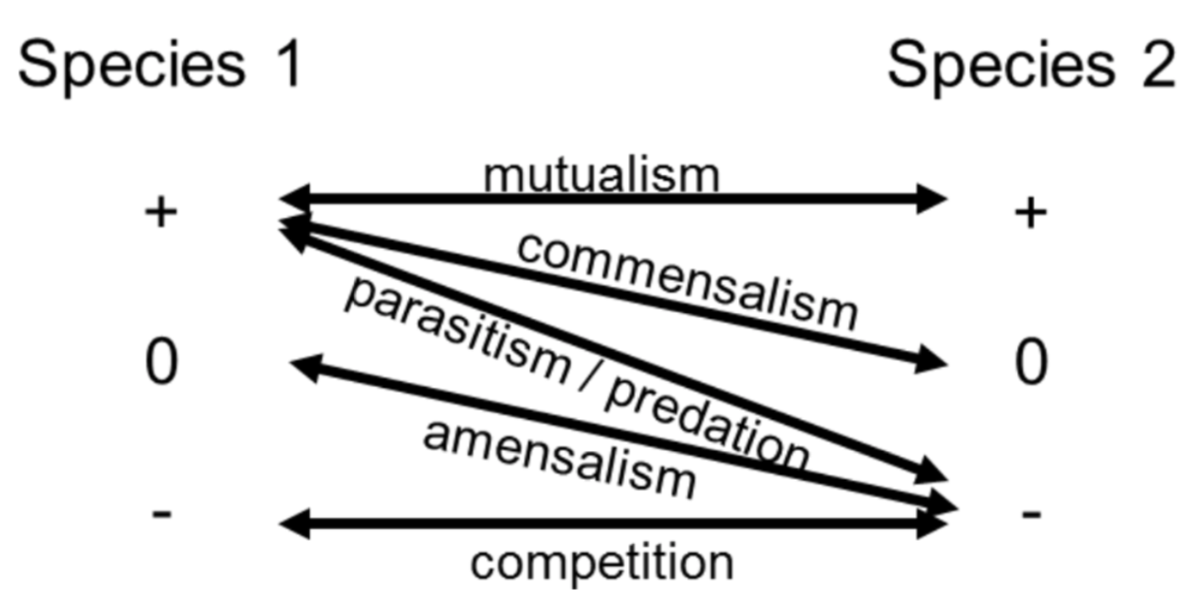
Defining symbiosis
Symbiosis: “A close and long-lasting association between two or more organisms of different species”
Modes of symbiosis
Mutualism (+,+)
Parasitism (+,-)
Commensalism (+,0)
Symbiosis is defined differently by different researchers and fields of study. The threshold between close association and symbiosis is artificial/operational, and varying criteria are considered, including duration of relationship, genomic interaction, and development of synergistic effects
McFall-Ngai M (2014)

Slide 4
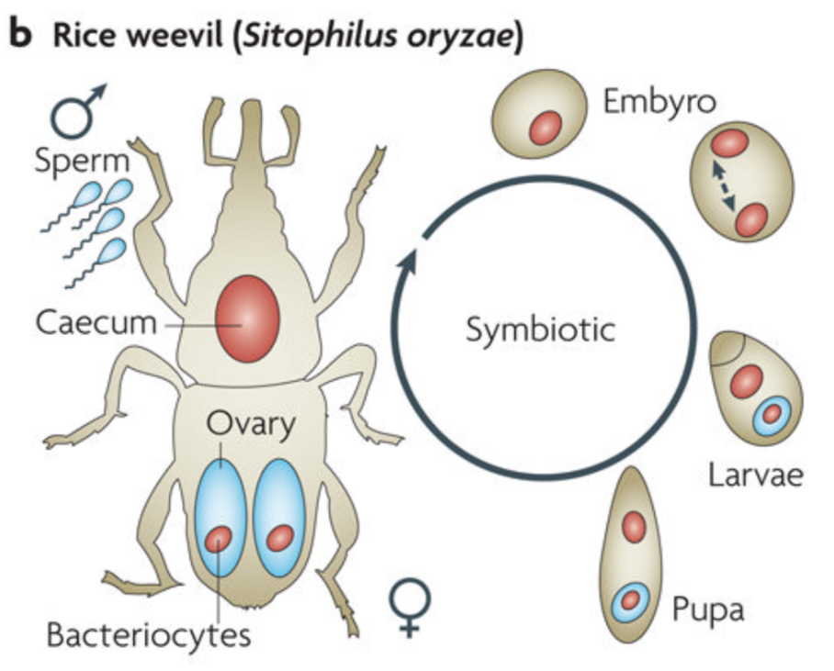
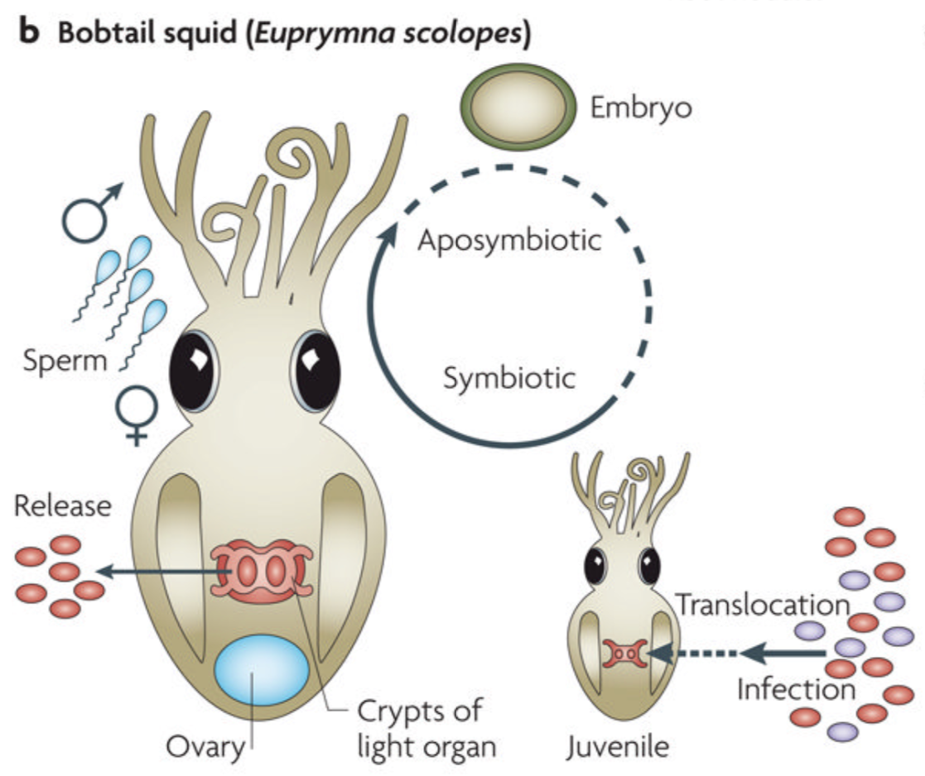
Acquiring symbionts
Vertical transmission
Symbiont is passed to progeny directly via germ line (found in egg) when chloroplasts, dinoflagellates already present in egg cells)
Horizontal transmission
Embryo is aposymbiotic
Host recruits/is infected by free-living form of symbiont
Bright & Bulgheresi 2010

Slide 5
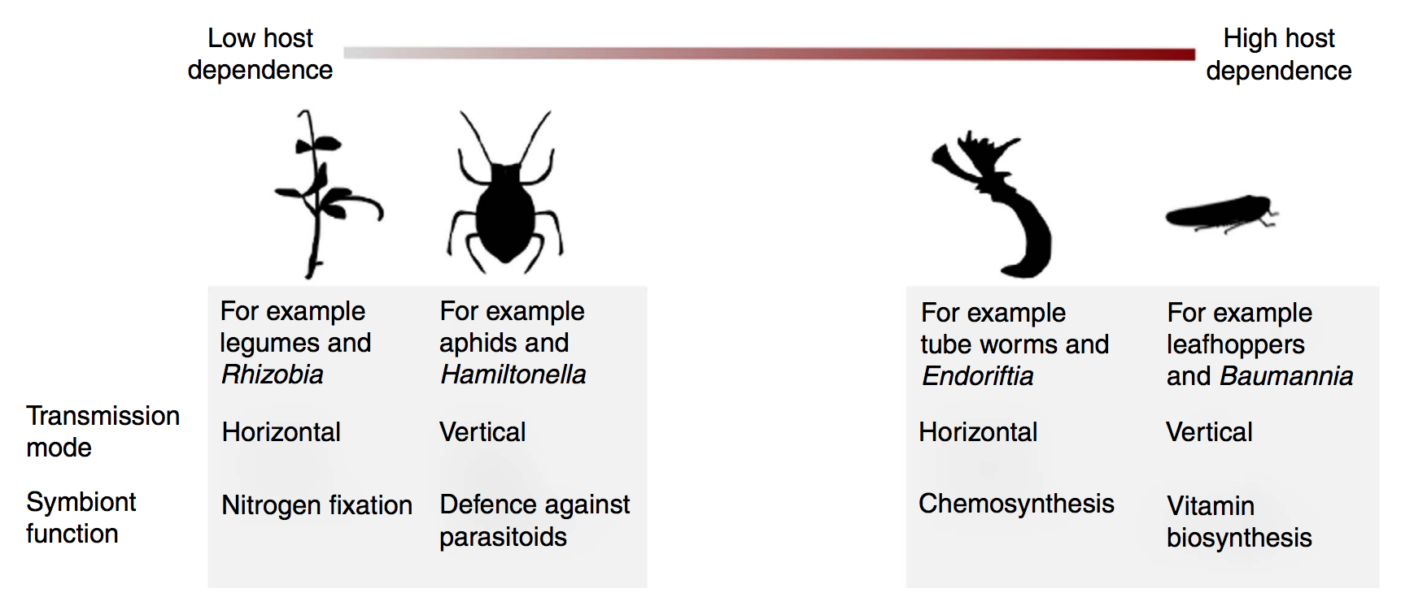
Host dependence
Obligate: mortality or large fitness cost associated with symbiont absence
Facultative: host can live/tolerate symbiont absence
Fisher et al. 2017

Slide 6
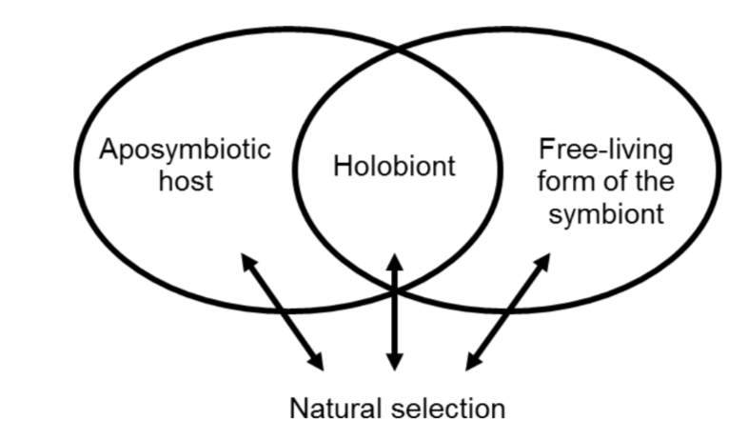
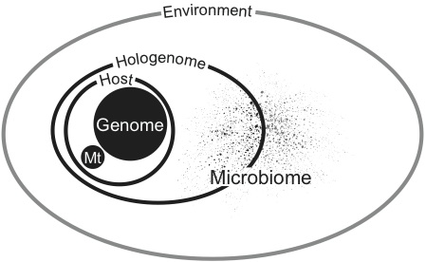
Holobiont theory of evolution
Holobiont: “A composite entity formed by a host and its symbionts. It is subject to natural selection” (Duperron 2017)
Hologenome: “The sum of genetic material of the host and its microbiota” (Zilber-Rosenberg & Rosenberg 2008)
Duperron (2017)
Brucker & Bordenstein (2013)

Slide 7
Holobiont theory of evolution
Hologenomic theory still debated/controversial (Douglas & Werren 2016)
To what extent does is the holobiont the dominant unit under selection? If it is, how often is this the case?
Some have suggested “symbiome” and “symgenome” as more neutral terms for the host-microbe community and the summed genomes, respectively (Boucias et al. (2013)
?
Duperron (2017)
Symgenome
Potential hologenome with single microbial symbiont
.
Brucker & Bordenstein (2013)

Slide 8
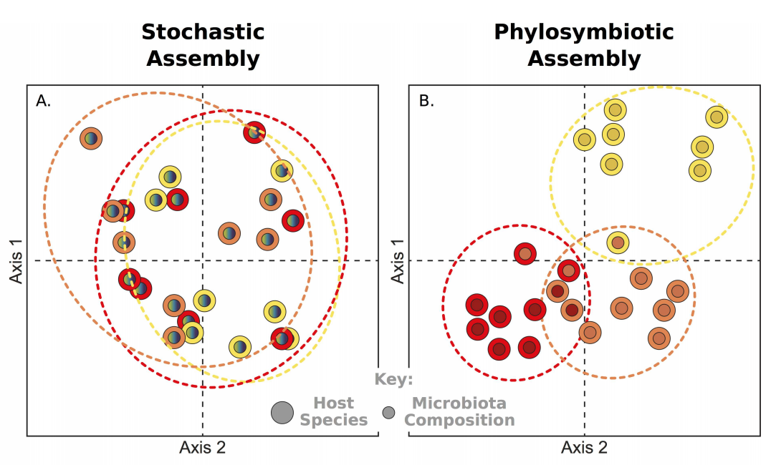
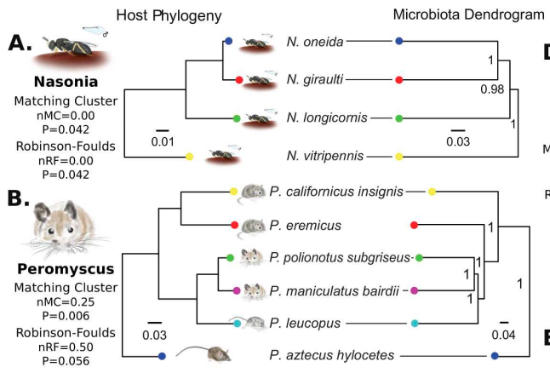
Phylosymbiosis
Relationships between species-specific microbiomes recapitulate host phylogeny
Occurs across eukaryotes
Species maintain own microbiome when grown together (Franzenburg 2013)
Has been used as proxy for partner fidelity, but be careful about this association
Brooks et al. (2016)

Slide 9
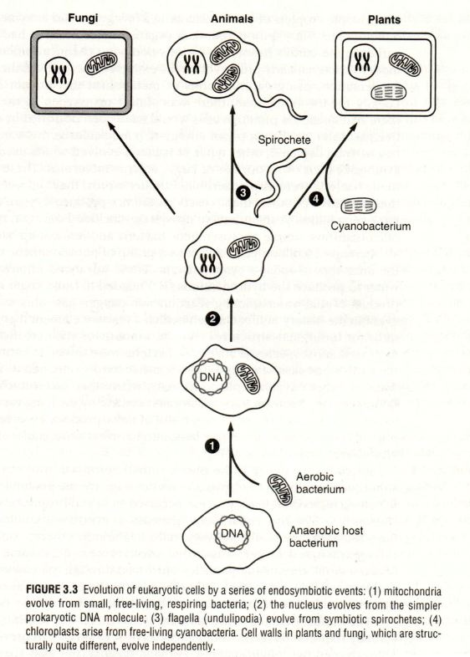
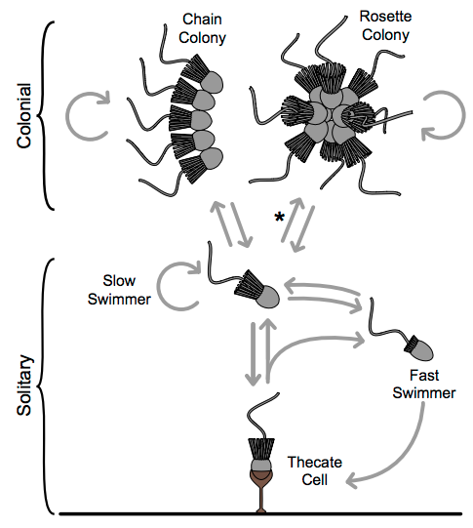
Symbiosis and major evolutionary transitions
Prokaryote → Eukaryote
Endosymbiotic theory argues that eukaryotes evolved out of symbiotic relationship between archaea and bacteria
Unicellular → Multicellular
Choanoflagellates are sister group to animals and bacteria can modulate their multicellularity
Dayel et al. 2011
https://msu.edu/course/lbs/145/luckie/set3.jpg

Slide 10
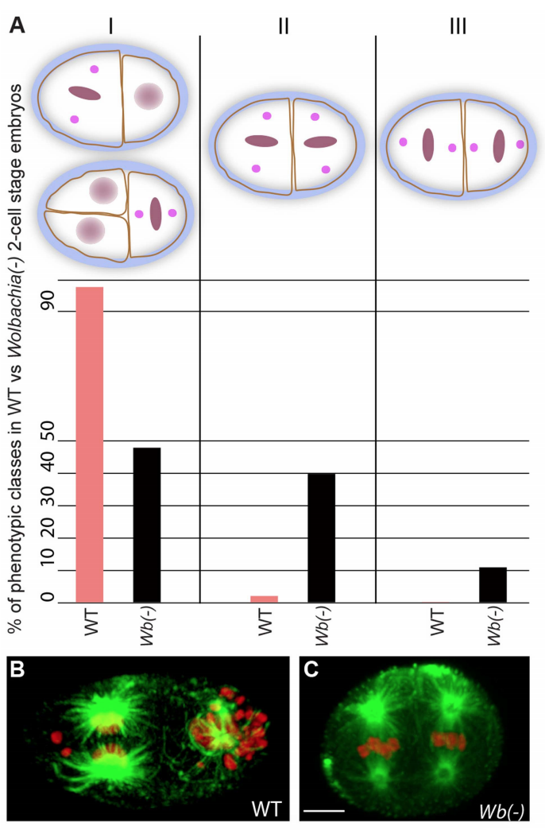
Developmental symbiosis
“Development is not complete without microbial interaction” – Gilbert 2016
Embryogenesis and organ development
Immune system
Behavior
Microbiome removal defects can be reversed upon reintroduction
Landmann et al. 2014

Slide 11
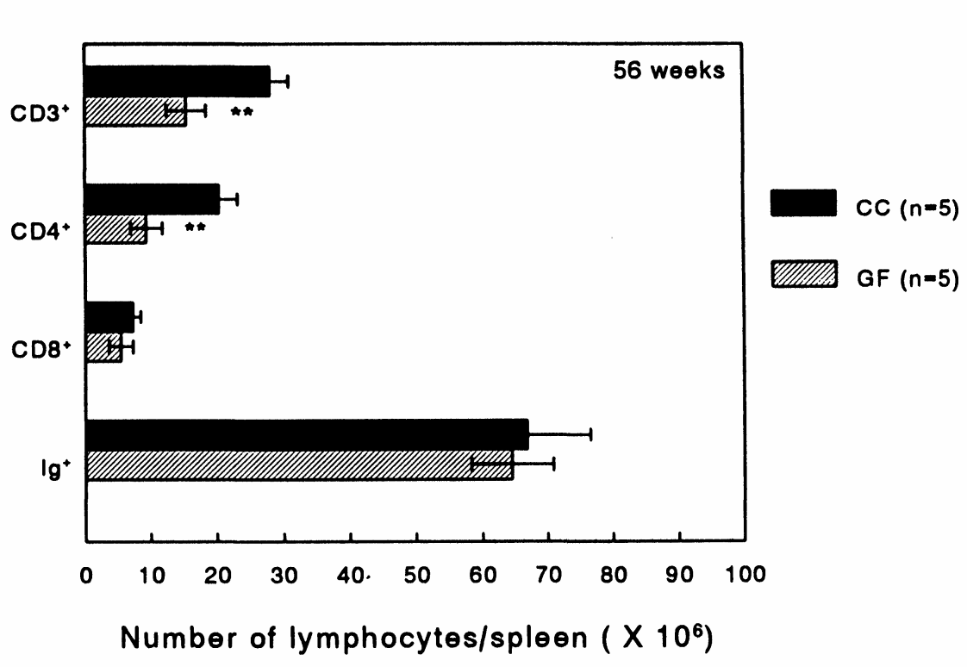
Developmental symbiosis
“Development is not complete without microbial interaction” – Gilbert 2016
Embryogenesis and organ development
Immune system
Behavior
Microbiome removal defects can be reversed upon reintroduction
Dobber et al. 1992

Slide 12
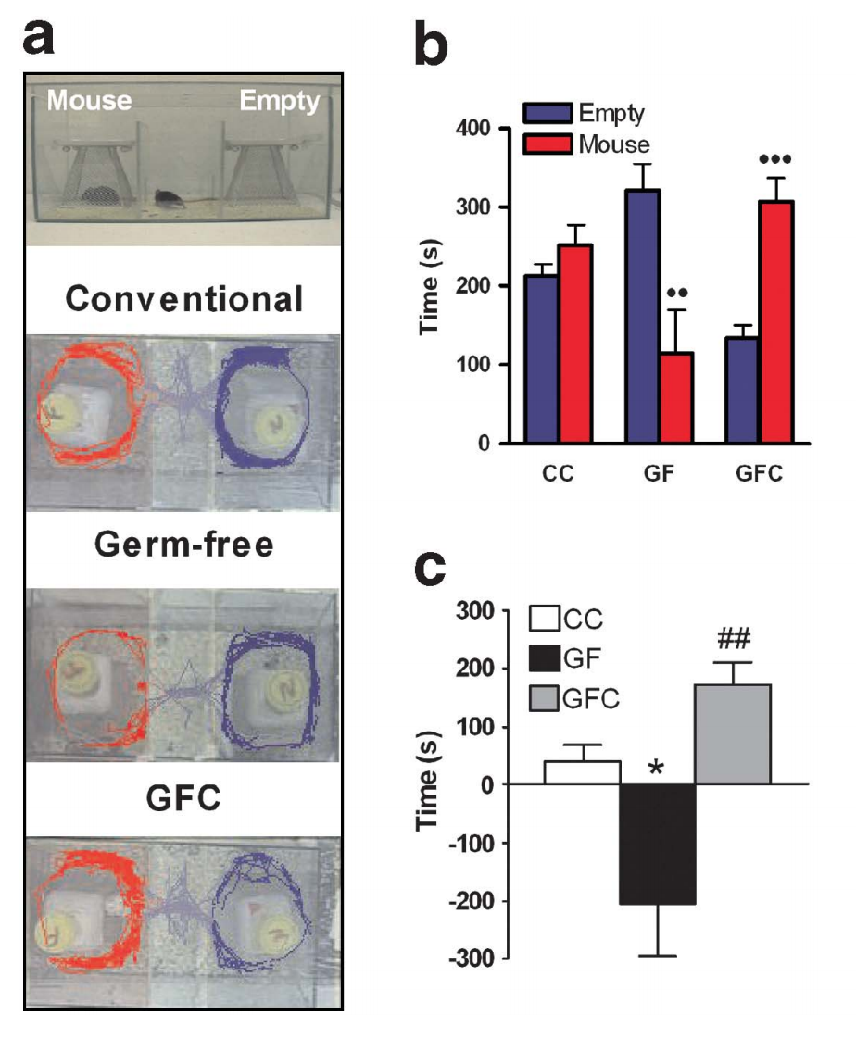
Developmental symbiosis
“Development is not complete without microbial interaction” – Gilbert 2016
Embryogenesis and organ development
Immune system
Behavior
Microbiome removal defects can be reversed upon reintroduction
Desbonnet et al. 2014

Slide 13
Developmental symbiosis
“Development is not complete without microbial interaction” – Gilbert 2016
Embryogenesis and organ development
Immune system
Behavior
Microbiome removal defects can be reversed upon reintroduction
Desbonnet et al. 2014

Slide 14
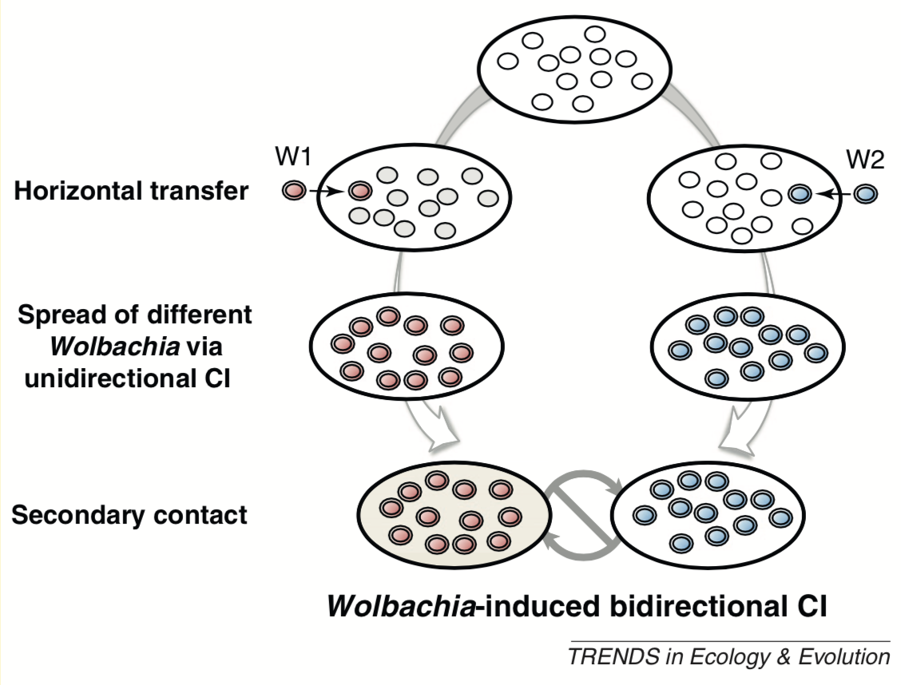
Symbionts and host speciation
Symbionts and microbiomes can strengthen reproductive isolation via (e.g.):
Cytoplasmic incompatibility (CI)
Post-mating issues
Behavioral isolation
Pre-mating issues
Reversible
Brucker & Bordenstein (2012)

Slide 15
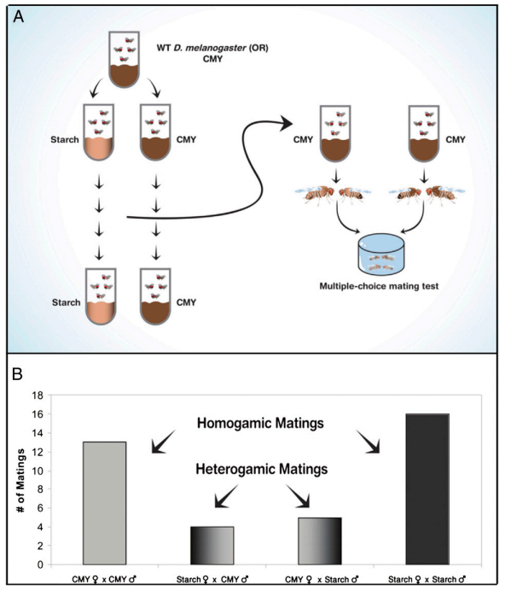
Symbionts and host speciation
Symbionts and microbiomes can strengthen reproductive isolation via (e.g.):
Cytoplasmic incompatibility (CI)
Post-mating issues
Behavioral isolation
Pre-mating issues
Reversible
Sharon et al. 2010

Slide 16
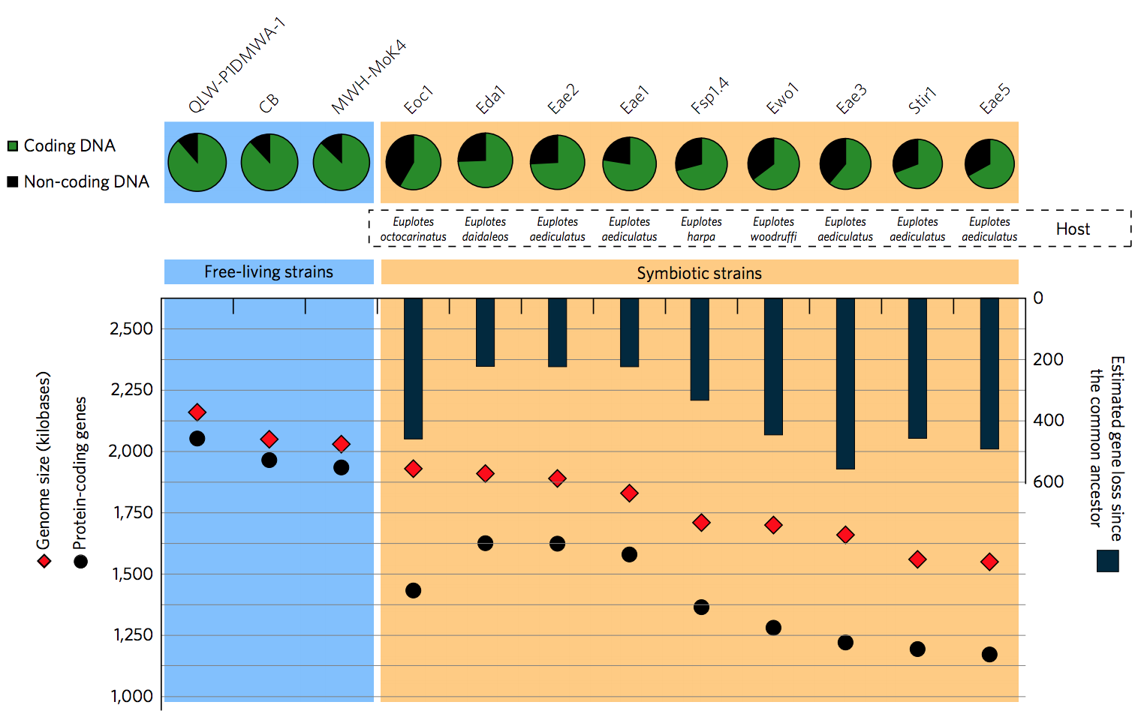
Genomic signatures of host-symbiont interactions
Genome reorganization
Symbiont genome reduction
(Boscaro et al. (2017)

Slide 17
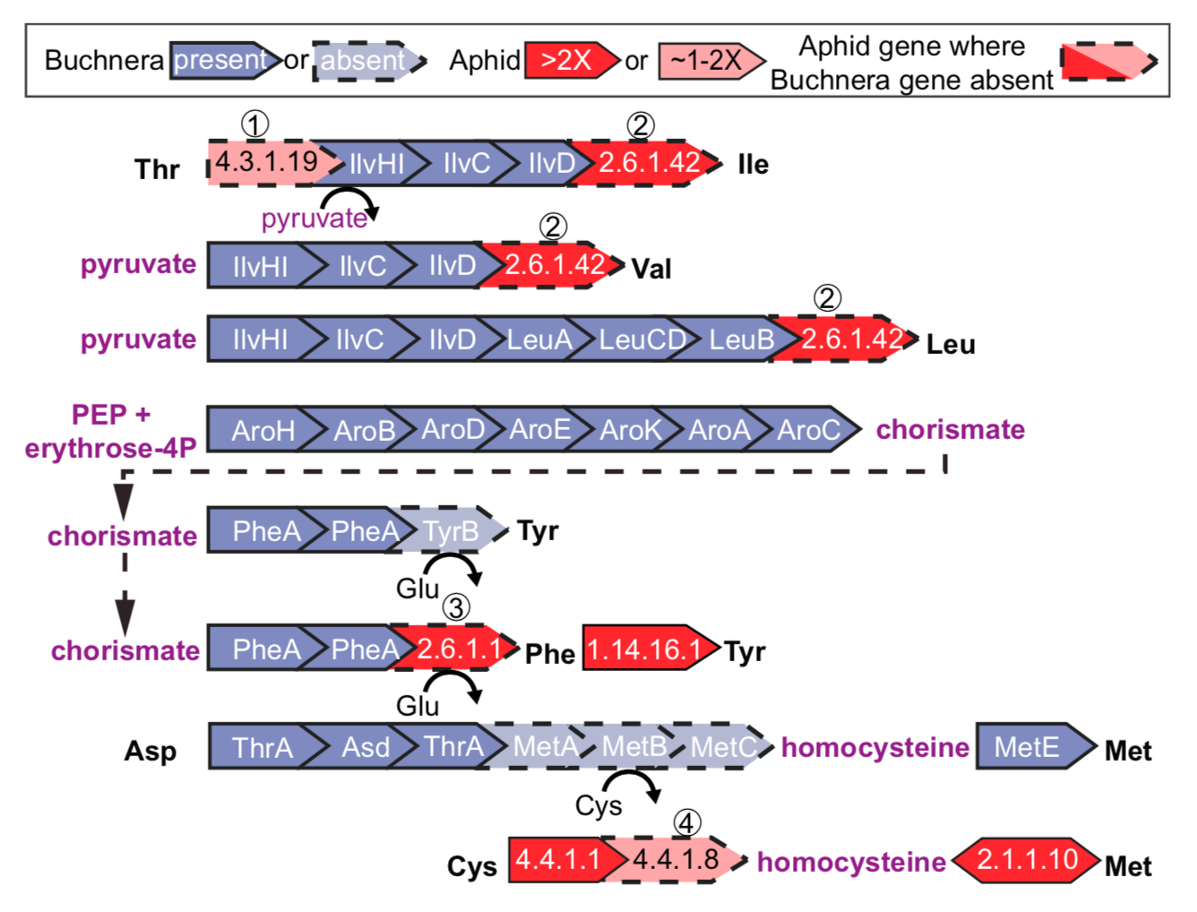
Genomic signatures of host-symbiont interactions
Genome reorganization
Symbiont genome reduction
Metabolic complementarity
Biosynthetic support: the extent to which species A relies on the metabolic network of species B
NetCooperate²⁶
Hansen & Moran 2011

Slide 18
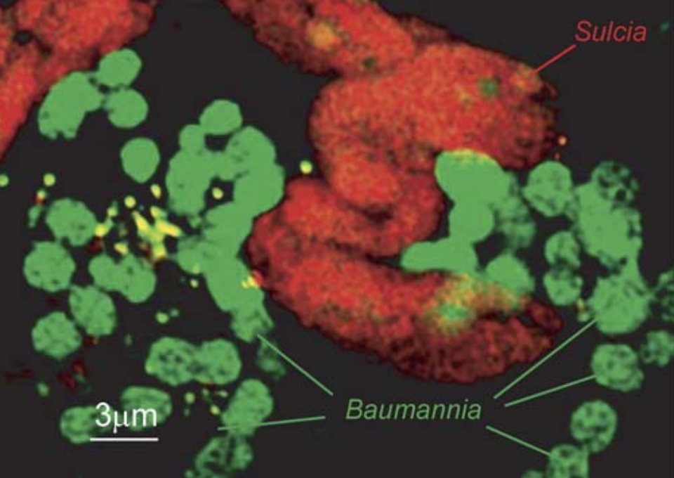
Genomic signatures of host-symbiont interactions
Genome reorganization
Symbiont genome reduction
Metabolic complementarity
Biosynthetic support: the extent to which species A relies on the metabolic network of species B
NetCooperate²⁶
Wu et al. (2006)

Slide 19
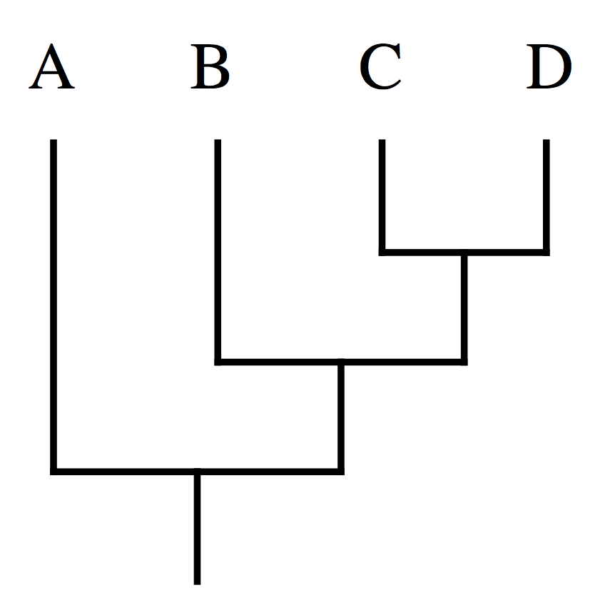
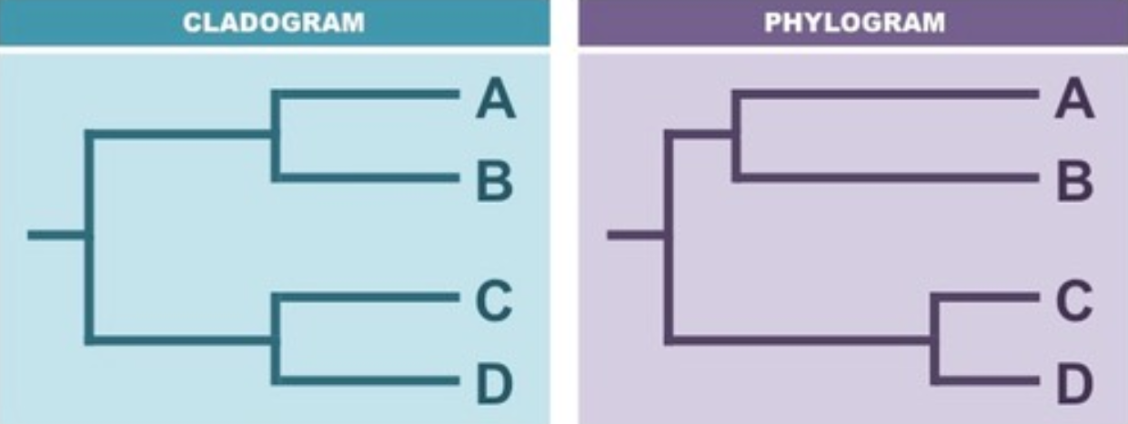
Phylogenetic Tree Basics
Outgroup
Ingroup
Terminal Node, or Leaf (present day species)
Internal Node (ancestor species, speciation event)
Evolutionary Time
Branch (length matters in phylograms, not cladograms)
Root

Slide 20
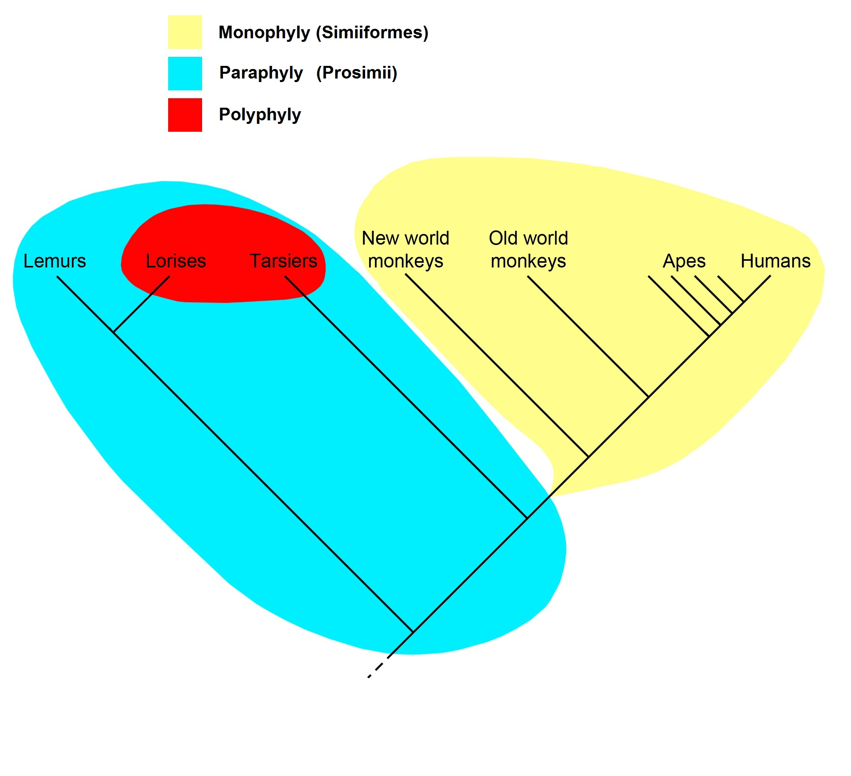
Phylogenetic Tree Basics
Monophyly
A group that includes a common ancestor and contains all descendants of that ancestor
Paraphyly
A group that includes a common ancestor but DOES NOT contain all descendants of that ancestor
Polyphyly
A group that is not defined by a common ancestor

Slide 21
Orthologs and Paralogs
Homologs
Genes that share common ancestry
Orthologs
Homologous genes found in different species, result of speciation event
Paralogs
Homologous genes, result of gene duplication event.
Distinguishing between orthologs or paralogs is important because:
Paralogs mess up assembly and mapping
Orthologs help determine function in unknown genes
Divergence patterns may differ between the two
You’ll want orthologs only for certain analyses (anything phylogenetic, synteny, etc)

Slide 22
Transposable elements (just a couple)
Long interspersed nuclear elements (LINEs)
Up to 7000 bp
~21% of human genome²²
Encode own reverse transcriptase
Short interspersed nuclear elements (SINEs)
80-500 bp
~13% of human genome²²
Do not encode own reverse transcriptase
Associated with many genetic diseases²³
Major factors in genomic evolution²⁴

Slide 23
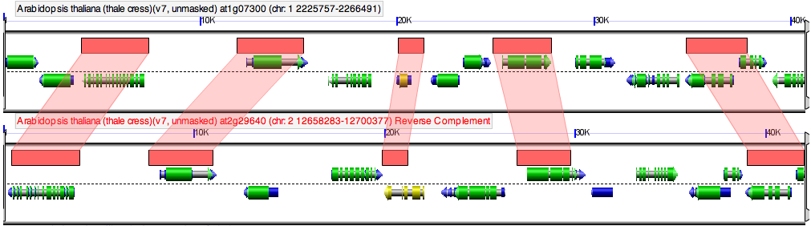
Synteny
https://genomevolution.org/wiki/images/4/4c/Gevo-synteny.png
Synteny: conservation of gene order in different species.
Why do we care?
Synteny can provide information about functional importance of gene co-localization
Important in establishing orthology in unknown genes
Syntenic patterns can be used as characters for phylogenetic analysis
Some tools for analysis and visualization
Synima (visualization)
Synmap (web client; max 3 species)
Circos (visualization)
Sibelia

Slide 24
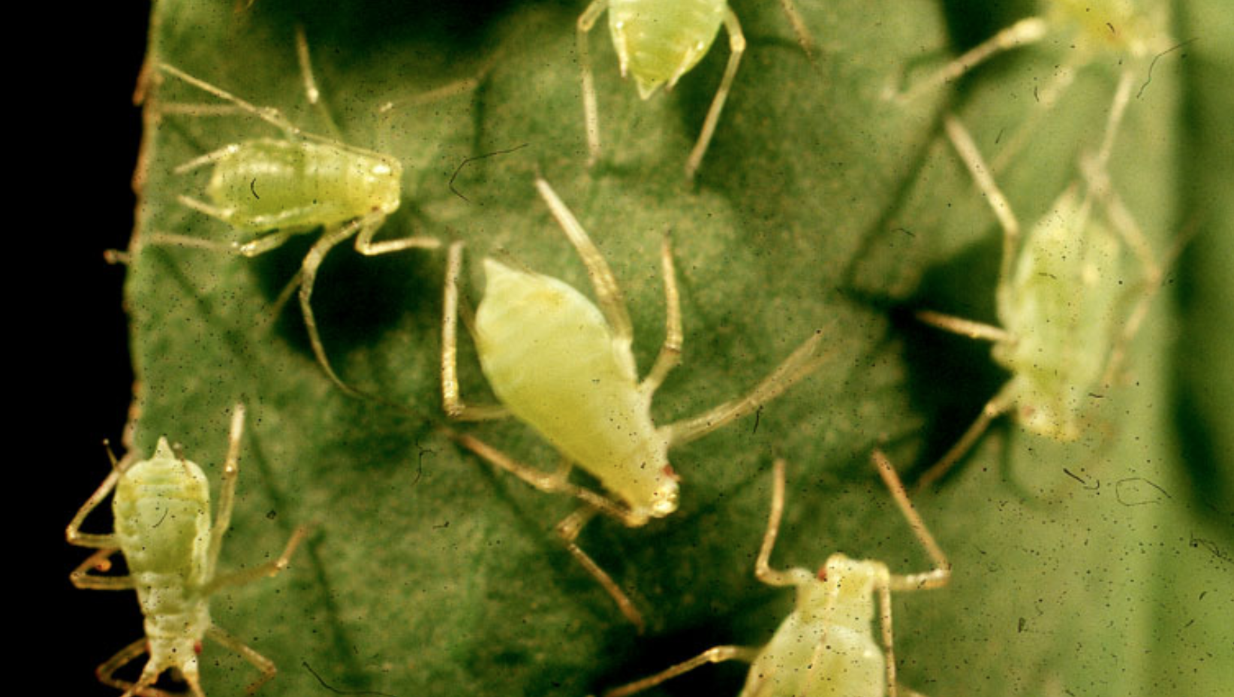
Discussion next week (3/26)
Belcaid et al. (2018)
Hansen & Moran (2011)

Slide 25
References
Boucias, D. G., Kariithi, H. M., Bourtzis, K., Schneider, D. I., Kelley, K., Miller, W. J., ... & Abd-Alla, A. M. (2013). Transgenerational transmission of the Glossina pallidipes hytrosavirus depends on the presence of a functional symbiome. PLoS One, 8(4), e61150.
Bright, M., & Bulgheresi, S. (2010). A complex journey: transmission of microbial symbionts. Nature Reviews Microbiology, 8(3), 218–230. https://doi.org/10.1038/nrmicro2262
Brooks, A. W., Kohl, K. D., Brucker, R. M., van Opstal, E. J., & Bordenstein, S. R. (2016). Phylosymbiosis: Relationships and Functional Effects of Microbial Communities across Host Evolutionary History. PLOS Biology, 14(11), e2000225. https://doi.org/10.1371/journal.pbio.2000225
Brucker, R. M., & Bordenstein, S. R. (2012). Speciation by symbiosis. Trends in Ecology & Evolution, 27(8), 443–451. https://doi.org/10.1016/j.tree.2012.03.011
Brucker, R. M., & Bordenstein, S. R. (2013). The capacious hologenome. Zoology, 116(5), 260–261. https://doi.org/10.1016/j.zool.2013.08.003
Douglas, A. E., & Werren, J. H. (2016). Holes in the Hologenome: Why Host-Microbe Symbioses Are Not Holobionts. MBio, 7(2). https://doi.org/10.1128/mBio.02099-15
Duperron, S. (2017). Microbial Symbioses. v. https://doi.org/10.1016/B978-1-78548-220-5.50001-5
Fisher, R. M., Henry, L. M., Cornwallis, C. K., Kiers, E. T., & West, S. A. (2017). The evolution of host-symbiont dependence. Nature Communications, 8, 15973. https://doi.org/10.1038/ncomms15973
Franzenburg, S., Fraune, S., Altrock, P. M., Künzel, S., Baines, J. F., Traulsen, A., & Bosch, T. C. (2013). Bacterial colonization of Hydra hatchlings follows a robust temporal pattern. The ISME journal, 7(4), 781.
Hansen, A. K., & Moran, N. A. (2011). Aphid genome expression reveals host-symbiont cooperation in the production of amino acids. Proceedings of the National Academy of Sciences, 108(7), 2849–2854. https://doi.org/10.1073/pnas.1013465108
²²International Human Genome Sequencing Consortium. (2001). Initial sequencing and analysis of the human genome. Nature, 409(6822), 860.
Kazazian, H. H. (2004). Mobile Elements: Drivers of Genome Evolution. Science, 303(5664), 1626–1632. https://doi.org/10.1126/science.1089670
Keeling, P. J. (2010). The endosymbiotic origin, diversification and fate of plastids. Philosophical Transactions of the Royal Society B: Biological Sciences, 365(1541), 729–748. https://doi.org/10.1098/rstb.2009.0103
McFall-Ngai, M. (2014). Divining the Essence of Symbiosis: Insights from the Squid-Vibrio Model. PLoS Biology, 12(2), e1001783. https://doi.org/10.1371/journal.pbio.1001783
Landmann, F., Foster, J. M., Michalski, M. L., Slatko, B. E., & Sullivan, W. (2014). Co-evolution between an endosymbiont and its nematode host: Wolbachia asymmetric posterior localization and AP polarity establishment. PLoS neglected tropical diseases, 8(8), e3096.
²⁶Levy, R., Carr, R., Kreimer, A., Freilich, S., & Borenstein, E. (2015). NetCooperate: a network-based tool for inferring host-microbe and microbe-microbe cooperation. BMC Bioinformatics, 16(1). https://doi.org/10.1186/s12859-015-0588-y
Padilla-Gamiño, J. L., Pochon, X., Bird, C., Concepcion, G. T., & Gates, R. D. (2012). From Parent to Gamete: Vertical Transmission of Symbiodinium (Dinophyceae) ITS2 Sequence Assemblages in the Reef Building Coral Montipora capitata. PLoS ONE, 7(6), e38440. https://doi.org/10.1371/journal.pone.0038440
Zilber-Rosenberg, I., & Rosenberg, E. (2008). Role of microorganisms in the evolution of animals and plants: the hologenome theory of evolution. FEMS Microbiology Reviews, 32(5), 723–735. https://doi.org/10.1111/j.1574-6976.2008.00123.x

